Slide 1
Global Classic Collections Product Analysis
By Swapna Macha
Updated on Nov-2024

Slide 2
Contents
Project Brief
Dataset Overview
Dataset Structure
Identified problems or challenges in the Dataset
Data Cleaning Process
Data Transformation
Insights and Findings (Slide 9 to 17)
Recommendations
Limitations of the Analysis

Slide 3
Project Brief
Global Classic Collections is a Premium retailer who offers high-end collectible products like model cars and airplanes, and they operate in multiple regions around the globe.
The company has seen some variances in sales across different offices and product lines. The Management is interested in understanding:
1. Which offices are performing the best and worst?
2. Which product lines are contributing most to the business?
3. How can they predict future sales trends based on historical data?
The goal is to help the company analyse their data and to provide actionable insights for decision making.
This presentation provides, a summary of analysis to answer the above questions and necessary recommendations to help Global Classic Collections improve its business strategy.

Slide 4
Dataset Overview
Data Source: https://www.mysqltutorial.org/getting-started-with-mysql/mysql-sample-database/
Description of the dataset: The classicmodels database has following tables:
Customers: 13 columns , 122 records.
Products: 8 columns, 23 records.
ProductLines: 4 columns,7 records.
Orders: 7 columns,326 rows
OrderDetails: 5 columns, 2996 rows
Payments:4 columns, 273 rows.
Employees:8 columns, 23 rows..
Offices: 9 columns, 7 rows.
The above data set helps to analyse the sales and performance of Global Classic Collections.

Slide 5
Dataset Structure
Table Name | Key Variable – Data Type
customers | country – Categorical customerNumber – Numerical salesRepEmployeeNumber – Numerical
employees | employeeNumber - Numerical officeCode - Numerical
offices | officeCode - Numerical country - Categorical city - Categorical
orders | orderDate – Date orderNumber - Numerical customerNumber – Numerical
order Details | orderNumber - Numerical quantityOrdered - Numerical priceEach - Numerical
products | productCode - Numerical productLine - Categorical
payments | Amount - Numerical customerNumber – Numerical paymentDate – Date

Slide 6
Identified Problems or Challenges in Dataset
Missing Data
Inconsistent Data Formats
Duplicate Records
Irrelevant or Redundant Data
Handling Null or Zero Values

Slide 7
Data Cleaning Process
Missing Data:
Identified missing values and determined whether they could be filled with defaults (e.g., average prices) or required exclusion.
Inconsistent Data Formats:
Converted orderDate and other similar fields to proper date formats.
Ensured numeric fields (e.g., quantityOrdered, priceEach) were correctly formatted as decimals for calculations.
Duplicate Records:
Removed duplicate rows based on unique identifiers such as orderNumber or customerNumber.
Irrelevant or Redundant Data:
Removed redundant or irrelevant columns (text Description columns).
Focused on using only the fields required for analysis, like orderNumber, priceEach, and productLine.
Handling Null or Zero Values:
Replaced null or zero values with default values

Slide 8
Data Transformation
Summary of Data Transformation
Extracted data from multiple tables in the MySQL Classicmodels database.
Merged, calculated, grouped, and transformed the data to provide insights into:
Office performance based on revenue, orders, and customer engagement.
Regional product popularity.
Time-based revenue trends and forecasts.
Please refer the below attached “Power Query Data Extraction and Transformation.docx” for more details.

Slide 9
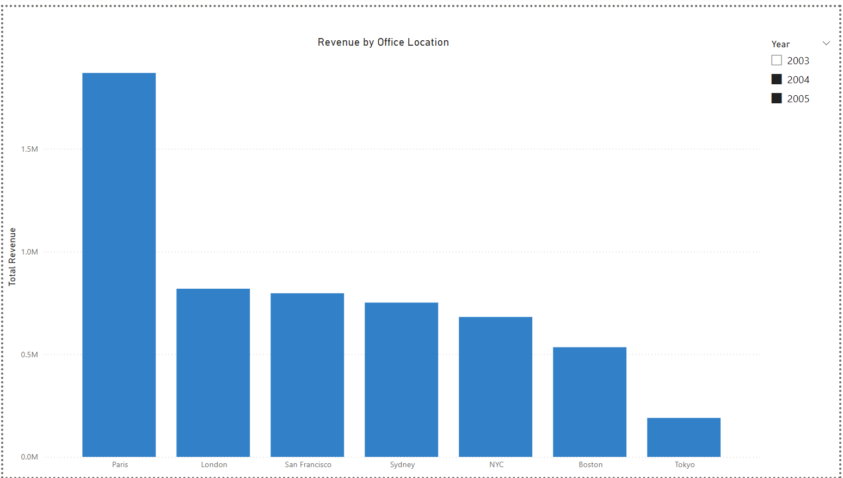
Revenue by Office location
The Paris office is performing the best with the highest revenue, while the Tokyo office is performing the worst with the lowest revenue

Slide 10
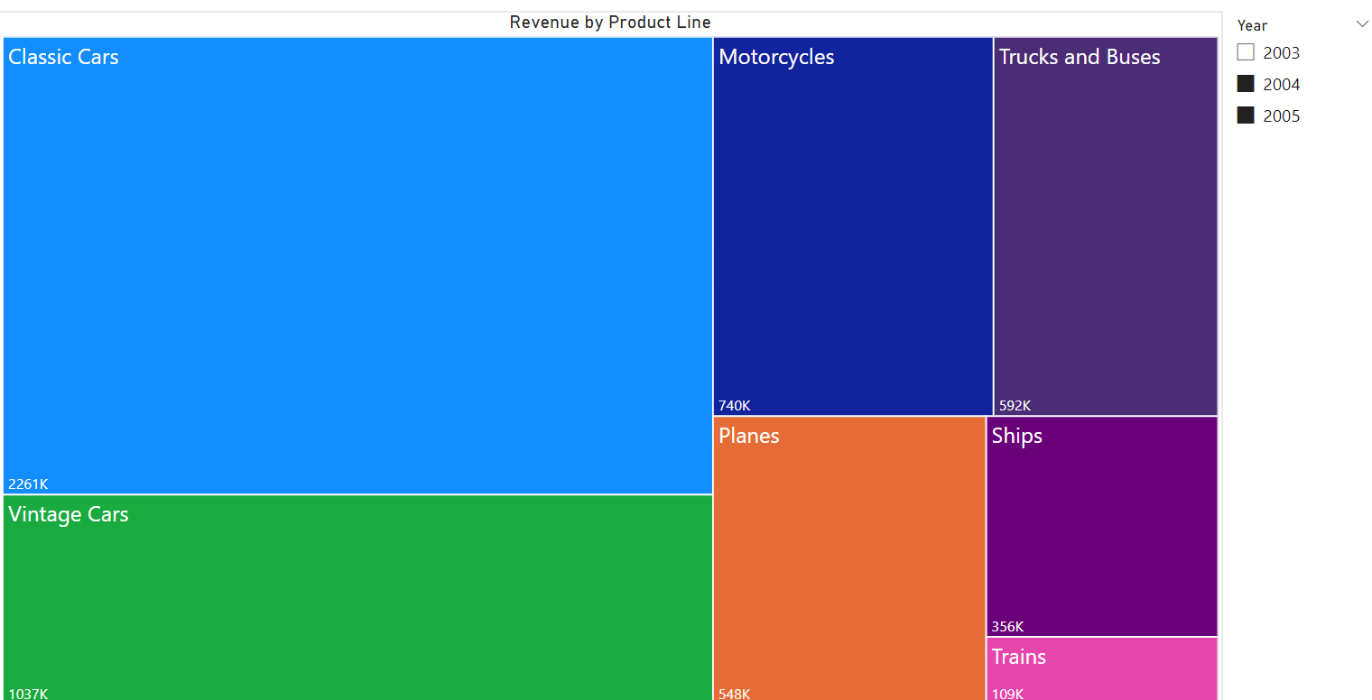
Revenue by product line
Classic Cars contribute the most to the business, generating the highest revenue, followed by Vintage Cars and Motorcycles

Slide 11
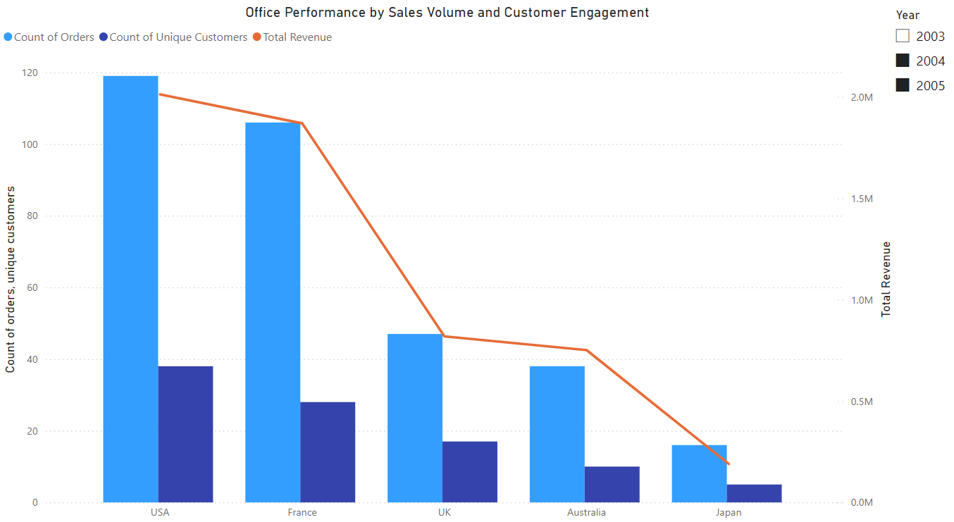
Diagnosis of performance by office
Japan shows the lowest performance across all metrics.
Japan's low performance seems to be due to ineffective marketing, products that don't match local preferences, and pricing that doesn't appeal to customers.

Slide 12
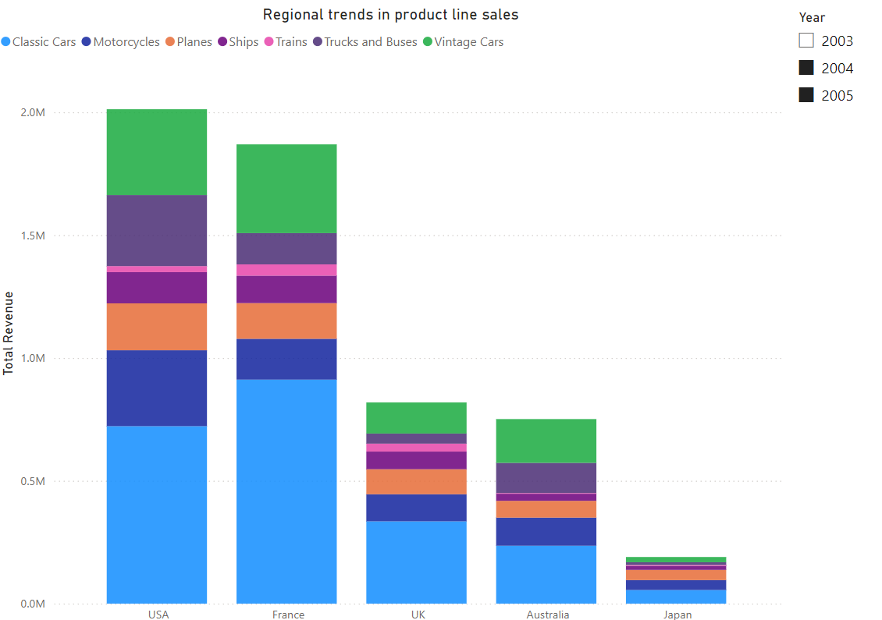
Diagnosis of product line popularity by region
Classic Cars, are more popular in regions like the USA and France due to cultural preferences, while Japan shows lower demand

Slide 13
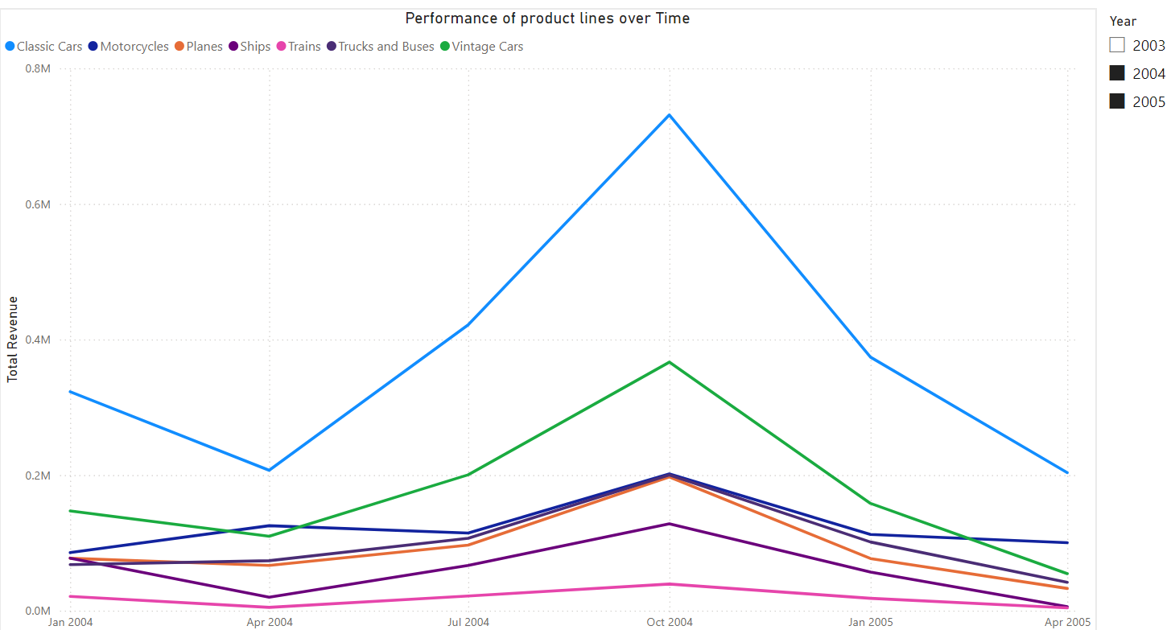
Product lines performance over time
Classic Cars is the top-performing product line, consistently generating the highest revenue

Slide 14
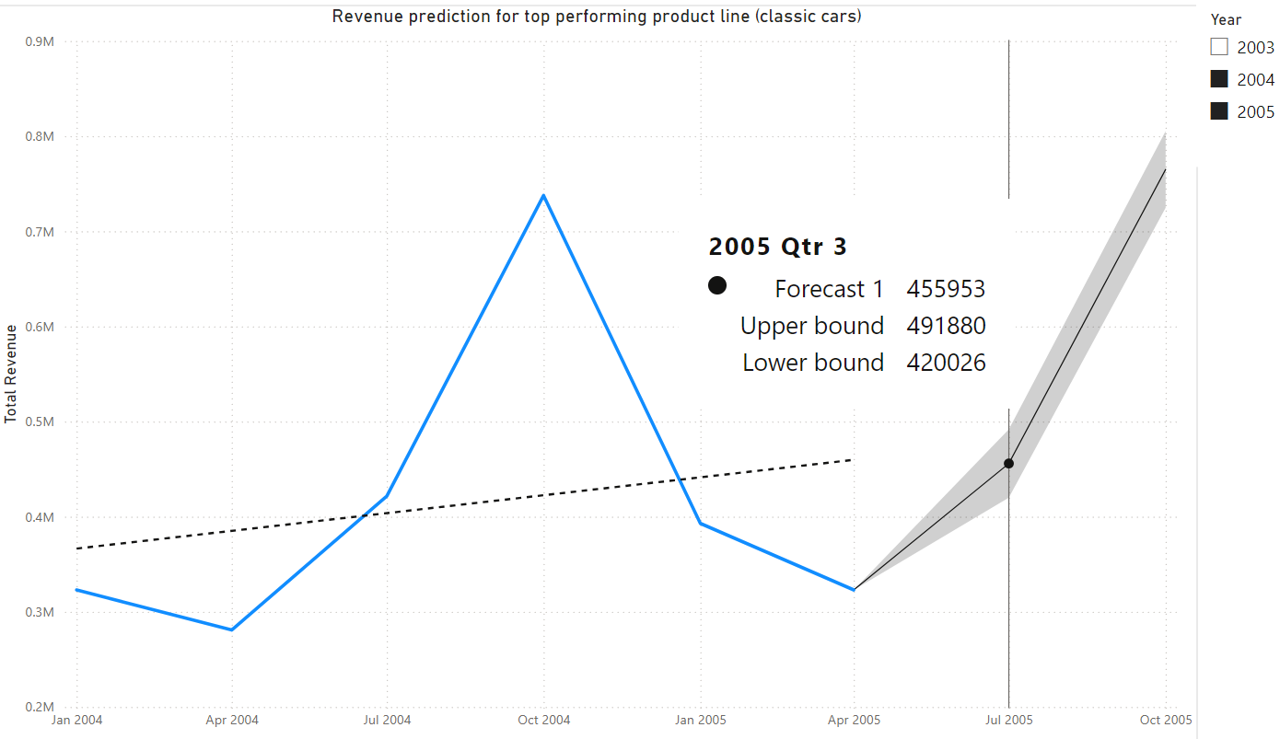
Prediction of top performing product line
The forecast for next quarter estimates Classic Cars revenue to be approximately $455,953

Slide 15
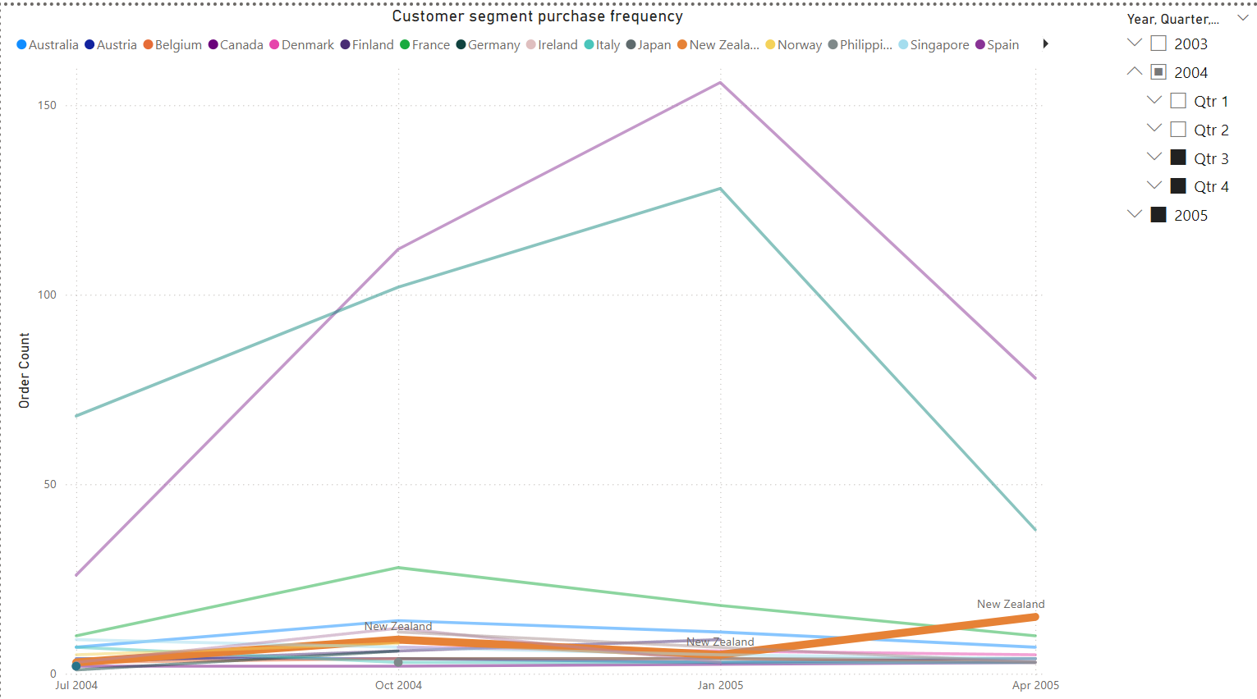
Customer segment purchase frequency
New Zealand's customers have steadily increased their purchase frequency over the past year, showing consistent growth.

Slide 16
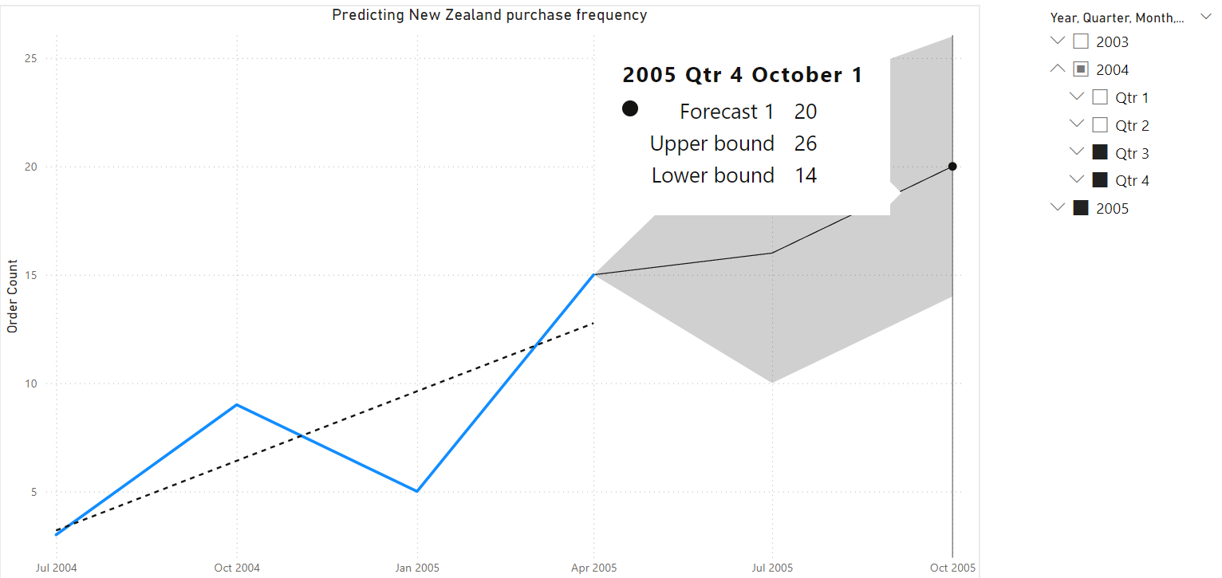
Predicting customer purchase frequency
Based on the forecast, New Zealand’s purchase frequency is expected to continue growing despite lower overall order counts compared to larger markets

Slide 17
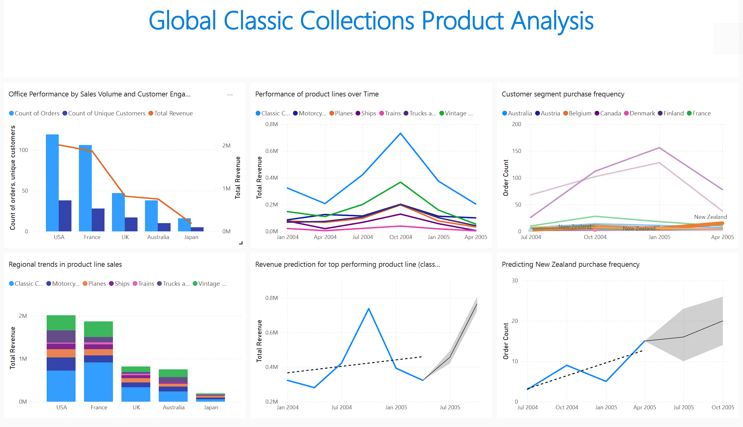

Slide 18
Recommendations
Focus on Classic Cars: Invest in top-performing product lines like Classic Cars and Vintage Cars.
Improve Tokyo's Performance: Increase Tokyo's revenue by targeting local preferences and improving customer engagement.
Regional Product Trends: Tailor products to regional preferences, as seen in the USA and France's love for Classic Cars.
Grow New Zealand Segment: Invest in growing the New Zealand customer base, as it shows steady growth in purchase frequency.
Forecast Top Products: Classic Cars are expected to generate ~$455,000 next quarter; prepare inventory accordingly.

Slide 19
Limitations of the Analysis
Missing data for regions or time periods may affect accuracy.
Predictions depend on historical data and may miss unexpected changes.
Limited insight into regional preferences may impact recommendations.
Lack of detailed customer insights limits behavior analysis.
Past marketing efforts weren’t analyzed, affecting conclusions.
Focus on revenue and orders may overlook profit or customer value.

